Slide 1
CS246: Web Characteristics
Junghoo “John” Cho

Slide 2
Web Characteristics
Size of the Web
Link structure of the Web

Slide 3
Web As A Graph
Page: Node
Link: Edge

Slide 4
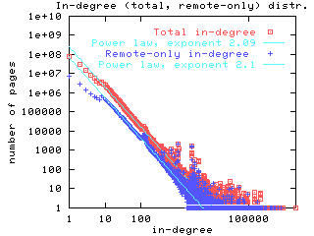
Link Degree
How many links?
In-degree
Power law
Why consistently 2.1?

Slide 5
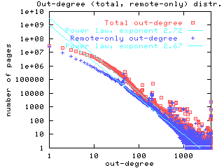
Link Degree
Out-degree

Slide 6
Large-Scale Structure?
Study by AltaVista & IBM, 1999 [BKM00]
Based on 200M pages downloaded by AltaVista crawler
“Bow-tie” result based on two experiments

Slide 7
Experiment 1: Strongly Connected Components
Strongly connected component (SCC):
C is a strongly connected component if: ∀a, b in C, there are paths from a to b and from b to a
SCC?
a
a
b
c
b
c
No
Yes

Slide 8
Result 1: SCC
Identified all SCCs from 200M pages
Biggest SCC: 50M (25%)
Other SCCs are small
Second largest: 150K
Mostly fewer than 1000 nodes

Slide 9
Experiment 2: Reachability
How many pages can we reach starting from a random page?
Experiment
Pick 500 random pages
Follow links in the Breadth-first manner until no more links
Repeated the same experiments following links in the “reverse direction”

Slide 10
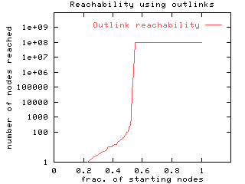
Result 2: Reachability
Out-links (forward direction)
50% reaches 100M
50% reaches fewer than 1000

Slide 11
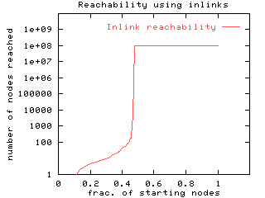
Result 2: Reachability
In-links (reverse direction)
50% reaches 100M
50% reaches fewer than 1000

Slide 12
What Can We Conclude?
50M (25%) SCC
SCC
(50M, 25%)

Slide 13
What Can We Conclude?
How many nodes would we reach from SCC?
Clearly not 1000, then 100M
50M more pages reachable from SCC (no way back, though)
SCC
(50M, 25%)
Out
(50M, 25%)

Slide 14
What Can We Conclude?
Similar result for “in-links” when we followed links backwards
50M more pages reachable by following in-links
SCC
(50M, 25%)
In
(50M, 25%)
Out
(50M, 25%)

Slide 15
What Can We Conclude?
25% Miscellaneous
(50M, 25%)
SCC
(50M, 25%)
In
(50M, 25%)
Out
(50M, 25%)

Slide 16
Questions
How did they “crawl” 50M In and 50M Misc nodes in the first place?
There may be much more In and Misc nodes that were not crawled (25% is lower bounds)
Only 25% SCC surprising (will be explained)

Slide 17
SCC
Q: How many edges are need to combine two SCCs into one?
If there are only two links, A → B and B → A, then A and B becomes one SCC.
A
B

Slide 18
Links between In, SCC and Out
No single link from SCC to In
No single link from Out to SCC
At least 50% of the Web “unknown” to the core SCC

Slide 19
Diameter of SCC
On average, 16 links between two nodes in SCC
The “maximum distance” (diameter) is at least 28

Slide 20
Questions?

Slide 21
References
[BKM00] Andrei Broder et al.: Graph structure in the Web. WWW 2000

